Slide 1
National Spectrum Management (NSM)
2nd meeting of Spectrum Work Group, SATRC March 2014
Dr. Azim Fard
Communications Regulatory Authority

Slide 2
Goals of National Spectrum Management
To promote efficiency of spectrum utilization
To support public communications, defense sector, utilities, transportation and safety of people
To support harmonized use of spectrum and orbits
To speed up national economical growth
To facilitate radiocommunication technology growth
To coordinate with international communities and neighbor countries

Slide 3
Structure of Communications Regulatory Authority
Communications Regulation Commission
President of CRA
Legal Affair
Organization Audit and Replying Complaints
Security
Public Relation
International Affairs
Inspection, Monitoring and Regulation Enforcement (Vice)
Licensing, Tariffication and Regulation (Vice)
Administrative Affairs of CRA (Vice)
Spectrum Monitoring
Radio Licensing and Planning
Planning and Budget
IT Services Monitoring
IT & Telecom. Network Licensing
HR
Telecom Services Monitoring
Number Management and Tariffication
Finance
USE Services Monitoring
Standardization and Type Approval
Procurement and Contracts
Regional Administrations (9 subsidiaries)

Slide 4
Structure of Radio Licensing
Director General
Deputy
Apparatus Licensing
Spectrum Planning and Engineering
Spectrum Licensing

Slide 5
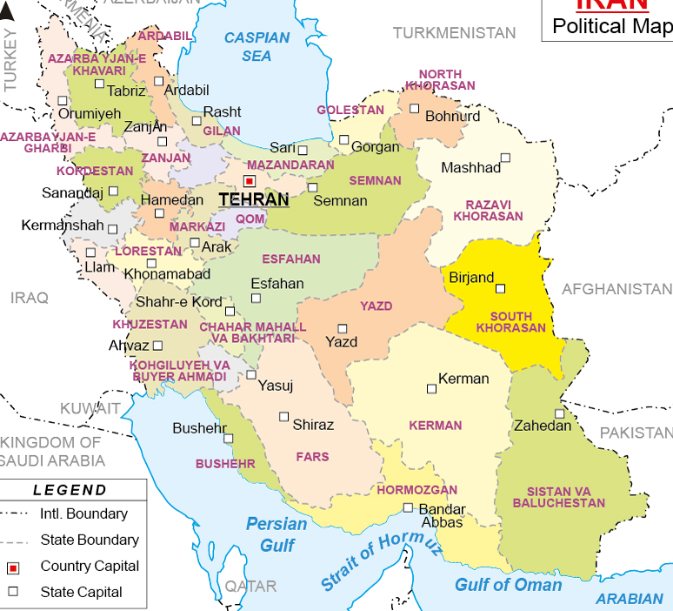
Regional Subsidiaries
Link to other Regional Administration and Headquarter
A Regional Administration
Spectrum Affairs
Several Remote Spectrum Monitoring stations

Slide 6
Major Tasks
Planning
N-FAT
Freq. Bands
Regulation
Licensing
Apparatus
Freq. Band
Class
Spectrum Monitoring
Inspection
Enforcement
Coordination
International Coordination
National Coordination
Permitting
Pilots
Custom Release
Manufacturing and Importing
Re-farming
Pricing
Registration
Certification

Slide 7
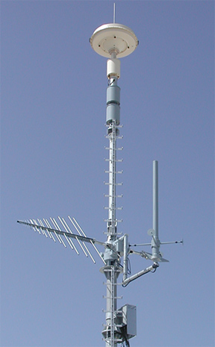
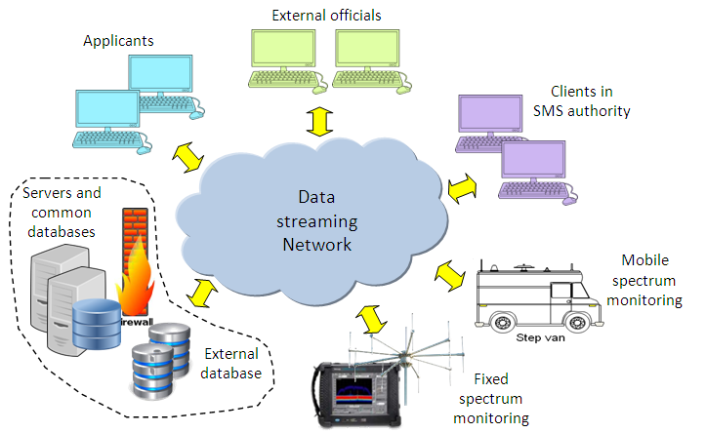
Capacity of NSM
~ 50 employees working directly in Headquarter
Web-based Local Spectrum Management System
More than 60 fixed spectrum monitoring sites
~ 30 employees working directly in Subsidiaries
More than 40 mobile spectrum monitoring vehicles
A type approval lab with network of cooperating accredited labs

Slide 8
Implemented Spectrum Management Procedures
Administration of variety of radio Licenses
Permitting of importers and manufacturers
Spectrum re-farming
Issuing of type approval certificates
Accreditation of test laboratories
Frequency band planning
Spectrum Pricing and billing
Issuing of type approval certificates
Auctioning

Slide 9
Licensing Statistics

Slide 10
Number of Issued Licenses in Various Frequency Bands
Frequency Ranges in MHz

Slide 11
Radiocommunication Stations Statistics

Slide 12
Table of National Frequency Allocations

Slide 13
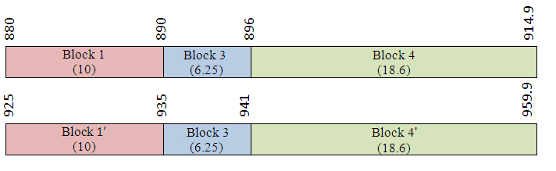
900 MHz Frequency Band

Slide 14
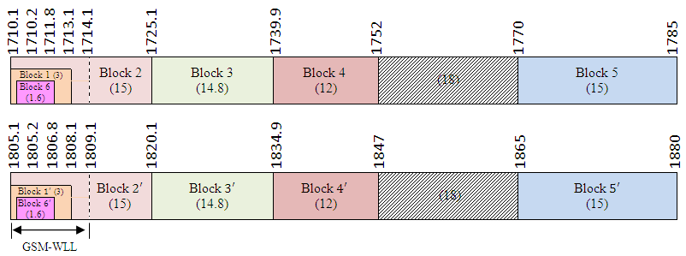
1800 MHz Frequency Band

Slide 15
2100 MHz and 2.6 GHz Frequency Band
2.6 GHz has not been licensed to operators yet

Slide 16
WiMAX Spectrum

Slide 17
Nationwide Public Radio Trunking
Feasibility study in 2010
auction held in 2012
License is ready to issue this March
Possibility for roll out by new operator
Very limited market
Individual licenses need to be forced to stop
Spectrum congestion and inefficiency
2*5 MHz in 410 MHz plus 3*5 MHz in 1800 MHz
43 participants
Three bidders

Slide 18
Radiation Exposure Measurement

Slide 19
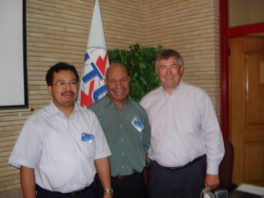
Center of Excellence
Collaborating in eight face-to-face or online training courses of ITU CoE node in Iran

Slide 20
Challenges
Implementation of digital dividend in 800 MHz and 700 MHz bands
Estimation of spectrum requirement and implementation of spectrum re-farming
Packing of Frequency Blocks for Broadband Bidders
Maximizing benefits of spectrum sharing

Slide 21
Thank you and Nice Stay

