Slide 1
Spectrum Re-farming
2nd meeting of SATRC Working Group on Spectrum, 11-12 March 2014, Tehran
Dr. Azim Fard
Communications Regulatory Authority

Slide 2
Causes of Spectrum Re-farming
Technology Change
12.5 kHz to 6.25 kHz
1.27 MHz to 5 MHz
Frequency Allocation Change
Dividing of big frequency bands between various services
Market Change
Entrance of new operator into market
Merger or dividing of operators
Wideband to Broadband
Analog to Digital
FDD to TDD
No more demand for old technologies
Aggregation of frequency bands in favor of specific services
Harmonization
Revenue optimization
Spectrum Re-farming is an inevitable task of spectrum management authorities

Slide 3
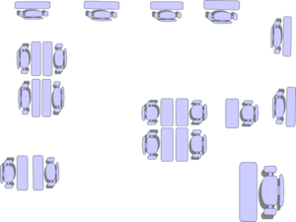
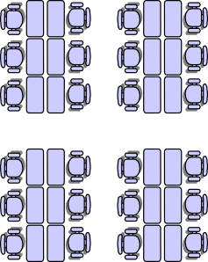
General Types of Spectrum Redeployment
Redeployment to other technologies
Redeployment to other frequency bands

Slide 4
Re-engineering Requirement
increasing the level of spectrum sharing
reducing the channel bandwidth to increase the number of channels
changing to more efficient modulation techniques that permit greater sharing
reducing the frequency reuse distance

Slide 5
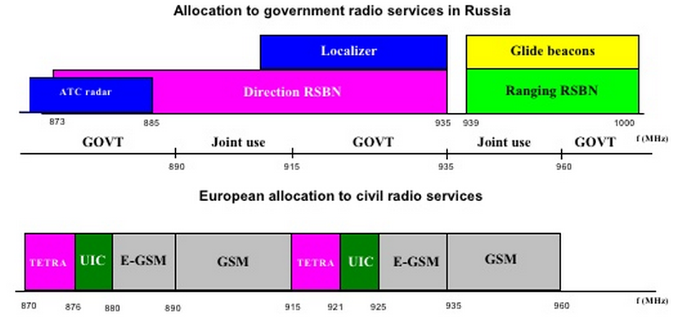
Example: Russian Experience in 900 MHz
About 80% of frequency bands allocated to government and military
Reference: V.O.Tikhvinsky, EMC Analysis Center

Slide 6
Example (cont.): Revenue / Infrastructure
900 MHz band in Russia
New operators
Traditional operators
New operators
Reference: V.O.Tikhvinsky, EMC Analysis Center

Slide 7
Initiators of Frequency Redeployment
Order of Higher Positions
Spectrum Management
Stakeholders
By Minister as Ministerial decree. Needs a legal support
Needs to be studied, planned and consulted by stakeholders
Administration of re-farming needs to be referred to Authority

Slide 8
Difficulty of Spectrum Redeployment
License Free Frequency Bands
Frequency Bands Licensed to Government
Frequency Bands Licensed to Operators
Frequency Bands Licensed to Individuals

Slide 9
Time Scale Requirement of re-farming
A flexible transition schedule is necessary to clear existing users and home new applications
10 years 20 years
Allocation change by ITU:
5 years
Based on end-user service change:
Notice of re-farming plan:
5 years 2 years
Now!

Slide 10
Redeployment Methods
Redeployment Methods
Regulatory spectrum redeployment
At the expiration of the current license
At the end of the equipment’s lifetime
Voluntary spectrum redeployment
-- Cost of use is more than benefit
-- Raising of spectrum price
Suitable for long term
-- re-farming is
Suitable for technology improvement
-- Common for license periods about 1 to 2 years
-- Claims for compensation if license validity is 10 to 15 or licensee was expecting license renewal automatically
-- Far advance announcement of redeployment
-- A fixed life time shall be set and then compensation may get necessary

Slide 11
Cost of Spectrum Redeployment
Method 1: Migration to frequency bands within the tuning range of the equipment
No cost or only requires costs of equipment re-tuning and test
Method 2: Migration into other frequency bands outside the tuning range
upgrading of RF sections and probably IF sections may get inevitable
May get impossible
May require a long transition period
Method 3: Migration to achieve greater spectral efficiency
Almost certainly require the purchase of some new equipment

Slide 12
Classification of Utilities (French experience from ITU-R SM.1603)
U_{incomer} > U_{outgoer} + C_{removal}
removal is socially and economically optimal
removal is not socially and economically optimal
U_{incomer} < U_{outgoer}
a choice has to be made
U_{outgoer} < U_{incomer} < U_{outgoer} + C_{removal}
U_{incomer} : utility of operator who replaces outgoer
U_{outgoer} : utility of operator leaving the spectrum
C_{removal} : spectrum redeployment cost

Slide 13
Preparing for Spectrum Redeployment
Evaluate the various cost elements
Propose a schedule for the redeployment operation
to organize the supervision of the procedure
To ask public to provide authority with their concerns
to manage the redeployment fund
Decide on redeployment principles
Licensing division is responsible for lunching procedure

Slide 14
Redeployment Plan
The dimension and complexity of a redeployment plan depends on urgency and significance of re-occupation. A redeployment plan, nevertheless case dependency, contains following information at least:
Legal position of plan and reference to higher regulations,
Introductory text explaining history of relevant plan;
Considering elements and reasons,
Plan milestones and timing,
Various phase of implementation,
Responsibility of Licensees,
Equipment certifications,
Refunding method and necessary steps to achieve if necessary

Slide 15
Implementation of Spectrum Redeployment
Issue a Notice in a official Gazette
Explain the reason of deployment
Determine the date on which license issuing would be stopped for old systems
Determine the final date on which redeployment has to fulfilled
Determine what new specification would get necessary for new applications
Determine available options for existing applications operating in the bands concerned
Provide more phased redeployment plan for different areas

Slide 16
Example: 100-500 MHz Spectrum Redeployment Plan in Canada (October 1998 ),
Published in Gazette stipulating
Policy framework
Setting principles such as gradual transition, suitability of transition periods to reflect future spectrum needs, Recognize the benefits from regional and international harmonization, etc
Phasing implementation
Phase 1: from 25/30 kHz channel spacing to 12.5/15 kHz
Phase 2: from 12.5/15 kHz channel spacing to 6.25/7.5 kHz

Slide 17
Funding Redeployment
Re-farming spectrum may impose costs. The cost of redeployment has to be evaluated before lunch of redeployment. This fund may be recovered by one of following methods:
Re-farming fund. In this case, a regulatory arrangement foresees a fund usable only for re-farming purpose under clear circumstance,
Using revenues from auction. The cost can be recovered by the collected license-fee at the time bidding for concerned frequency band
Reducing spectrum fees. This is almost a long-term solution for recovering licensee’s expense at the time of migration to new frequency band

Slide 18
Thank you and Nice Stay

